Slide 1
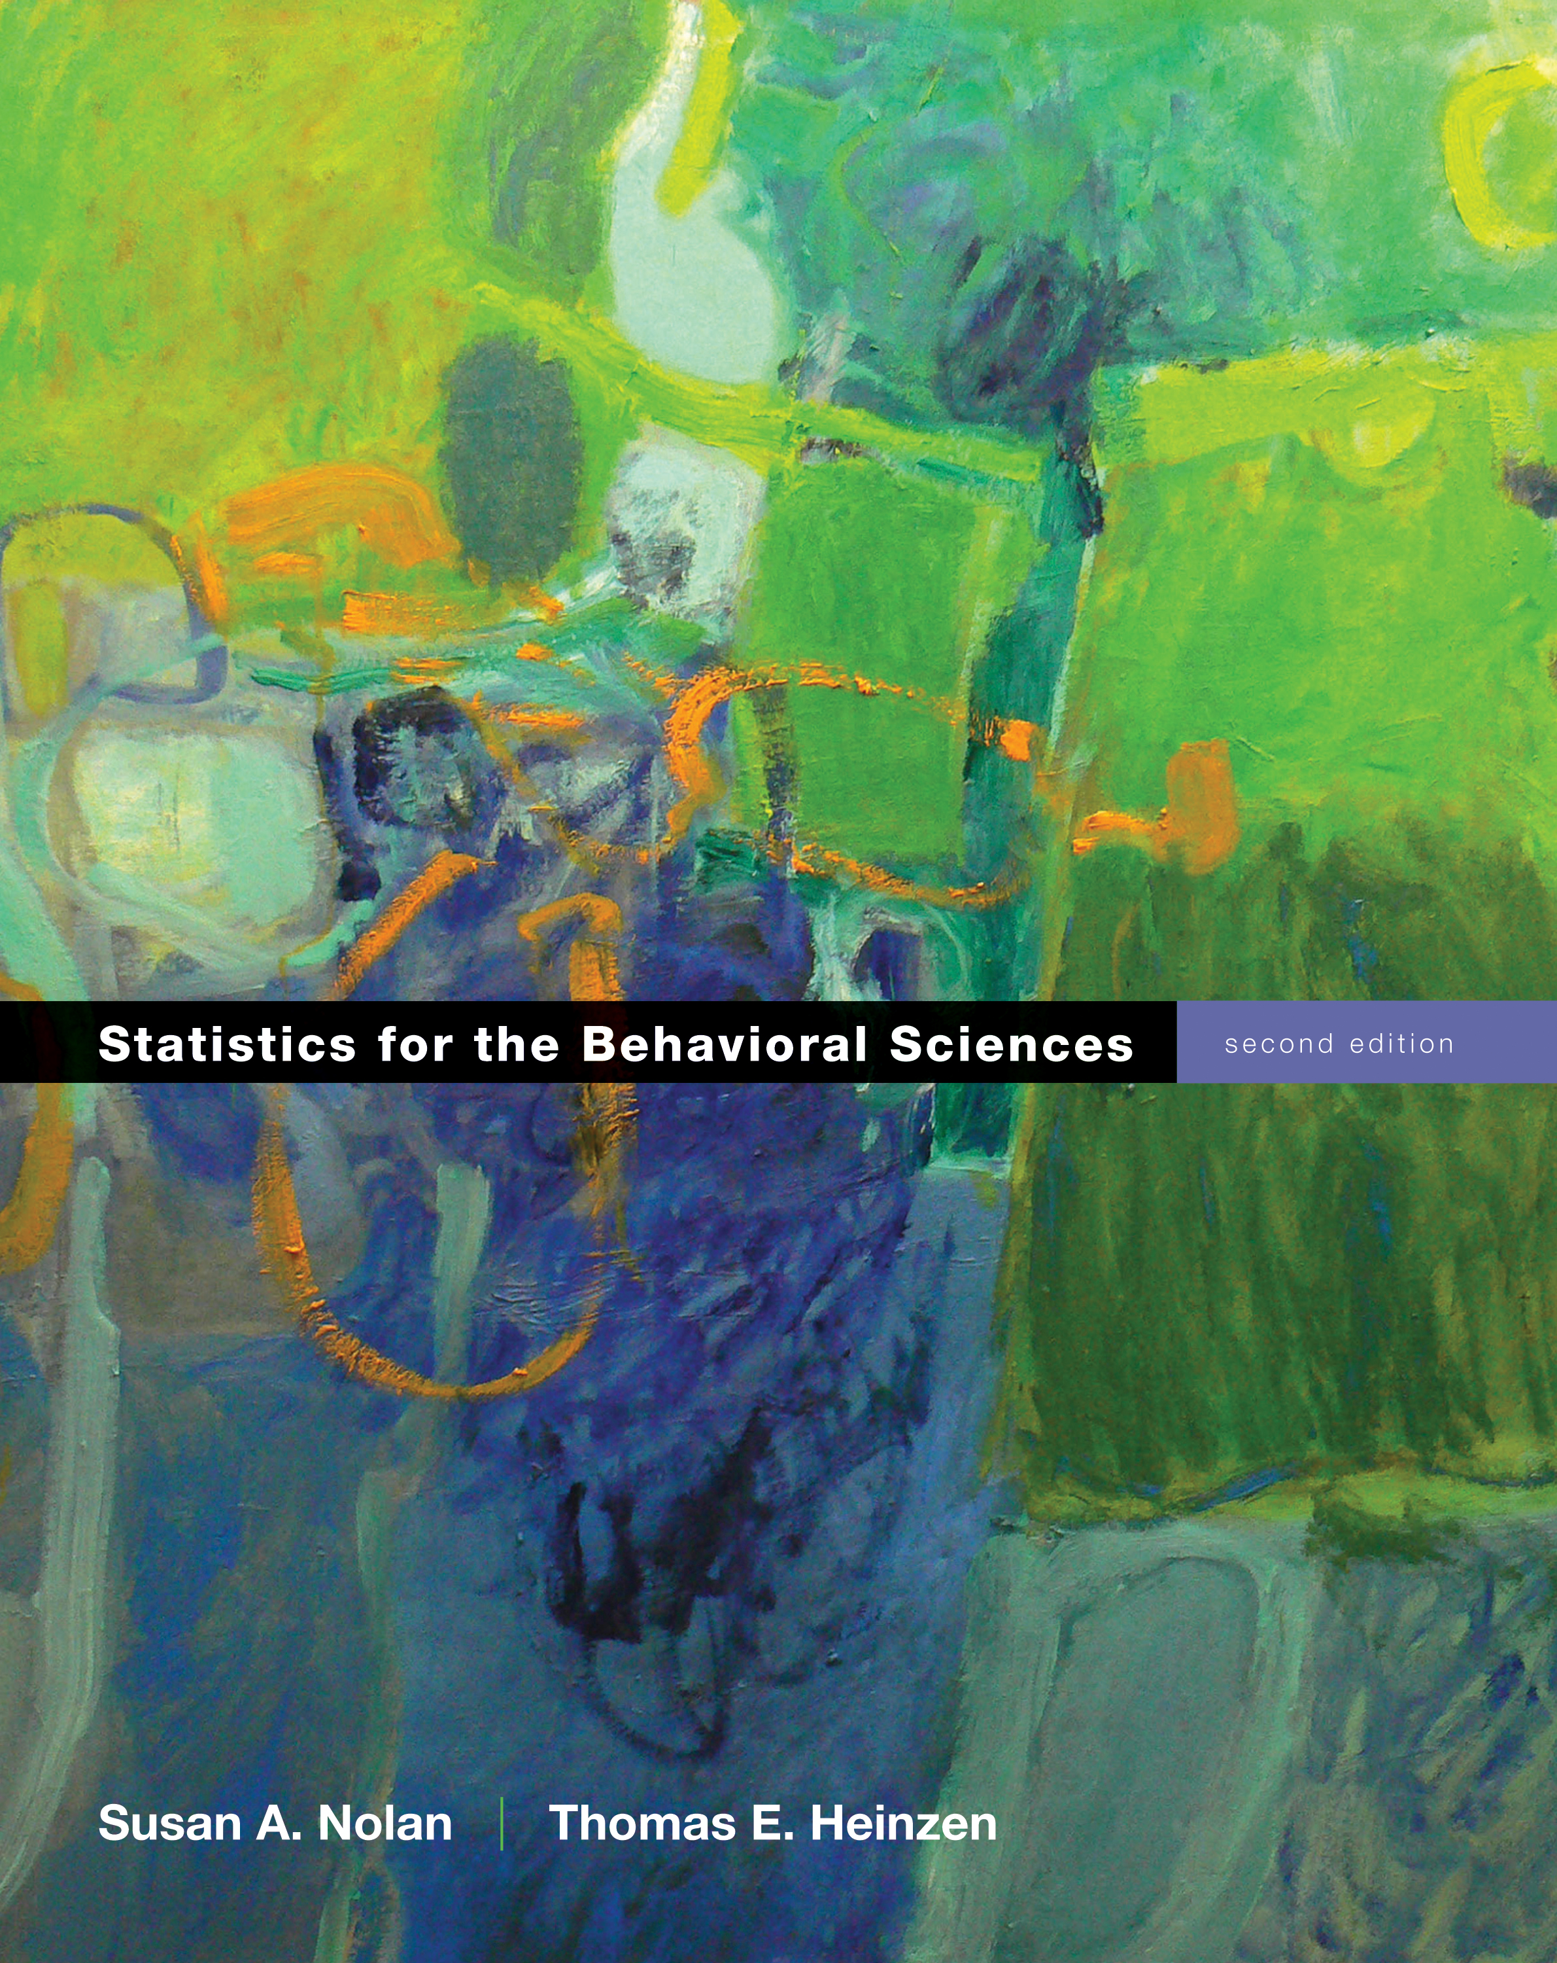
Regression
Chapter 16

Slide 2
Regression
Builds on Correlation
The difference is a question of prediction versus relation
Regression predicts, correlation describes relations

Slide 3
Simple Linear Regression
A statistical tool that lets us predict an individual’s score on the DV based on the score on one IV
Multiple linear regression uses more than one IV

Slide 4
Linear Regression
a = Intercept: predicted value of Y when X is equal to 0
Mean of Y
b = Slope: the amount that Y is predicted to increase for an increase of 1 in X

Slide 5
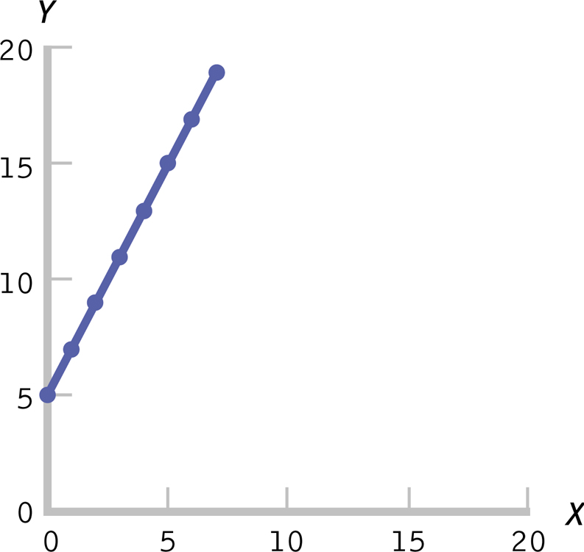
The Equation for a Line

Slide 6
Standardized regression coefficient
Statisticians love to standardize things.
Beta = standardized coefficient
It’s a z score of the slope value
WHY? Comparisons.
Beta = r with ONE predictor!

Slide 7
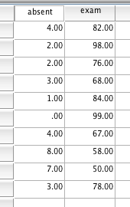
SPSS
Since I have two scores from each person, be sure to line them up side by side.
Open the dataset online!
Political talk!

Slide 8
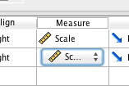
SPSS
Under variable view, be sure both are listed as scale – otherwise you won’t be able to create the right type of graph.

Slide 9
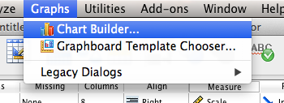
SPSS
Graph > Chart Builder

Slide 10
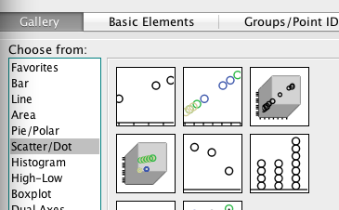
SPSS
Click on scatter/dot, and drag/drop the first box into the graph building area.

Slide 11
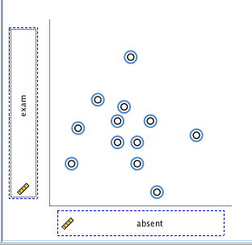
SPSS
Drag one variable into X, one variable into Y.
Remember, this view is NOT the real scatterplot.

Slide 12
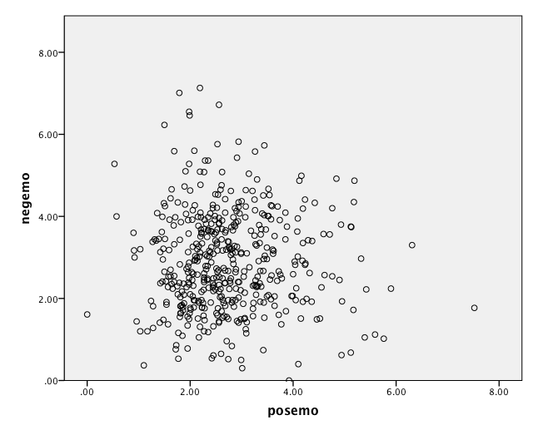
SPSS
Hit ok!

Slide 13
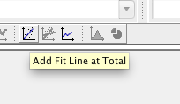
SPSS
Double click on the graph.
Click add fit line at total.

Slide 14
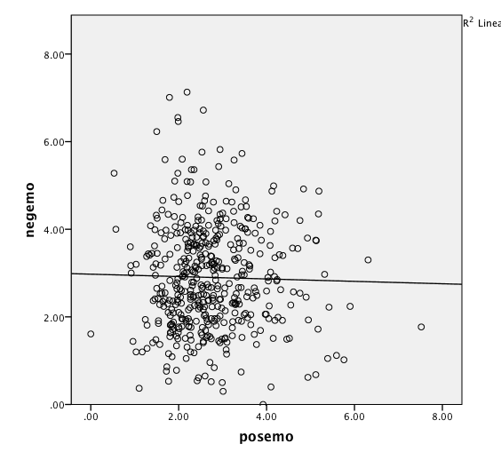

Slide 15
SPSS
Starting with a scatterplot helps you to see what the regression equation should look like.
Dots that are closer to the line indicate a better regression equation.

Slide 16
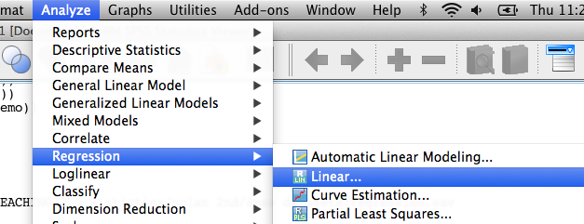
SPSS
How to get the regression equation.
Analyze > regression > linear.

Slide 17
SPSS
Put your IV into independents (X).
Put your DV into the dependent box (Y).
Hit ok!

Slide 18
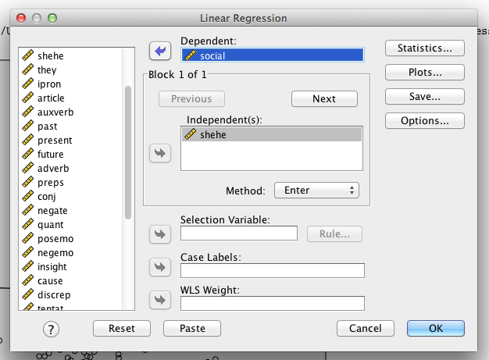
SPSS

Slide 19
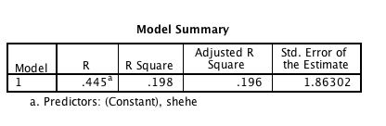
SPSS

Slide 20
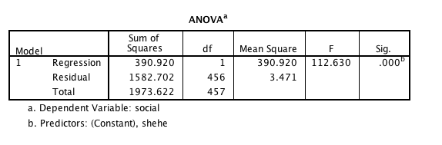
SPSS

Slide 21
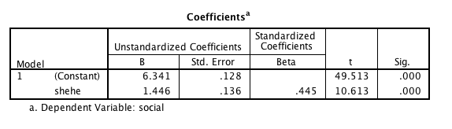
SPSS
Y = 6.34 + 1.45X
What if I was saying 25 pronouns per speech?

Slide 22
Assumptions
Random selection
X and Y are at least scale variables
X and Y are both normal
Homoscedasticity (for real this time!)
Each variable must vary approximately the same at each point of the other variable.
See scatterplot for UFOs, megaphones, snakes eating dinner.

Slide 23
Regression Hypothesis Testing
Step 1. Identify the population, distribution, and assumptions
Step 2. State the null and research hypotheses.
Step 3. Determine the characteristics of the comparison distribution.
Step 4. Determine the critical values.
Step 5. Calculate the test statistic
Step 6. Make a decision.

Slide 24
Hypothesis Steps
Step 1:
Population: people where IV does not predict DV (i.e. b = 0)
Sample: people where IV does predict DV

Slide 25
Hypothesis Steps
Step 2:
Null: No relationship between pronouns and social words (b = 0)
Research: Relationship between pronouns and social words (b/=0)

Slide 26
Hypothesis Steps
Step 3:
List regression equation – but specifically beta values
Notice relationship between beta and r
List the df = N – 2 = 456

Slide 27
Hypothesis Steps
Step 4
List the cut off score p < .05
+ and – 1.96

Slide 28
Hypothesis Steps
Step 5:
List the t value from the table = 10.61
(don’t use the constant)

Slide 29
Hypothesis Steps
Step 6:
Reject! 10.61 > 1.96

Slide 30
Hypothesis Steps
Effect size
R² = proportionate reduction in error
Same rules as ANOVA applies
S = .01
M = .06
L = .14

Slide 31
Proportionate Reduction in Error
Also called the coefficient of determination
Quantifies how much more accurate our predictions are when we use the regression line instead of the mean as a prediction tool
Explaining what R² actually means

Slide 32
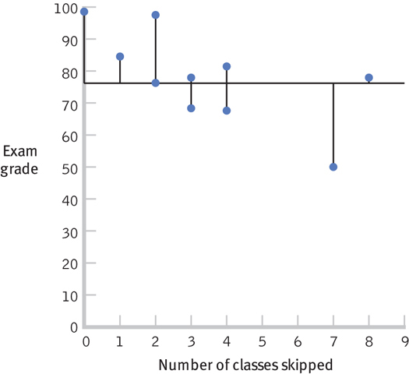
Visualizing Error

Slide 33
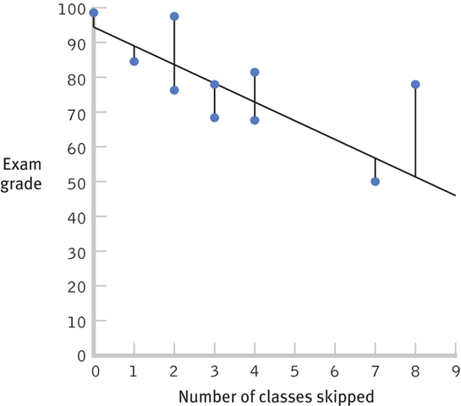
Visualizing Error

Slide 34
SPSS
R square box on SPSS
R² = .20
Don’t use the adjusted box.

Slide 35
Regression Issues
Standard error of the estimate
Regression to the mean

Slide 36
Regression with z Scores
This section is confusing and dumb.

Slide 37
Interpretation and Prediction
Standard error of the estimate
Indicates the typical distance between the regression line and the actual data points
Often called least squared error

Slide 38
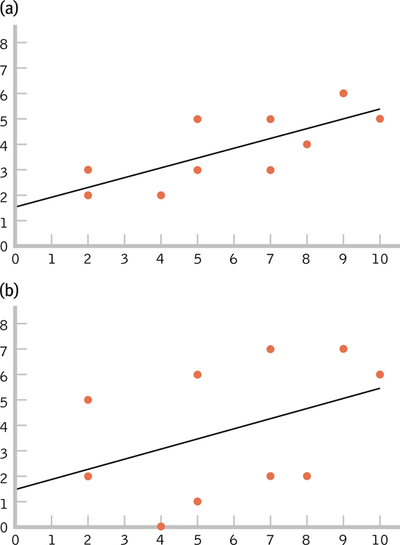
The Standard Error of the Estimate
Which figure makes the stronger prediction? Why?

Slide 39
Regression to the mean
The patterns of extreme scores

Slide 40
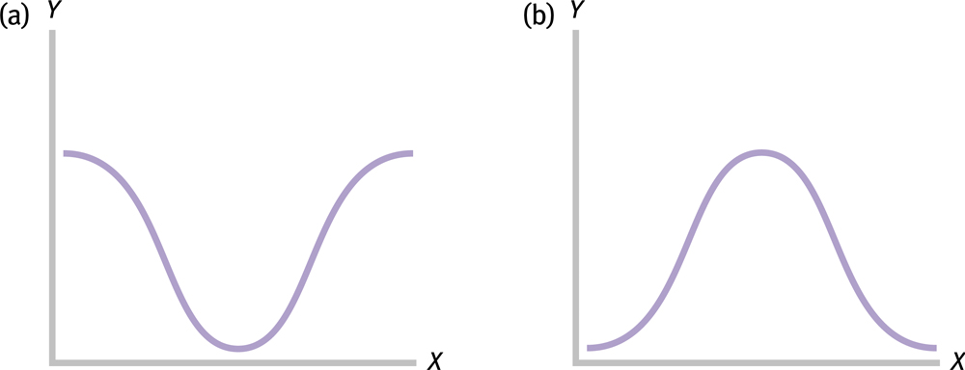
Regression to the Mean

Slide 41
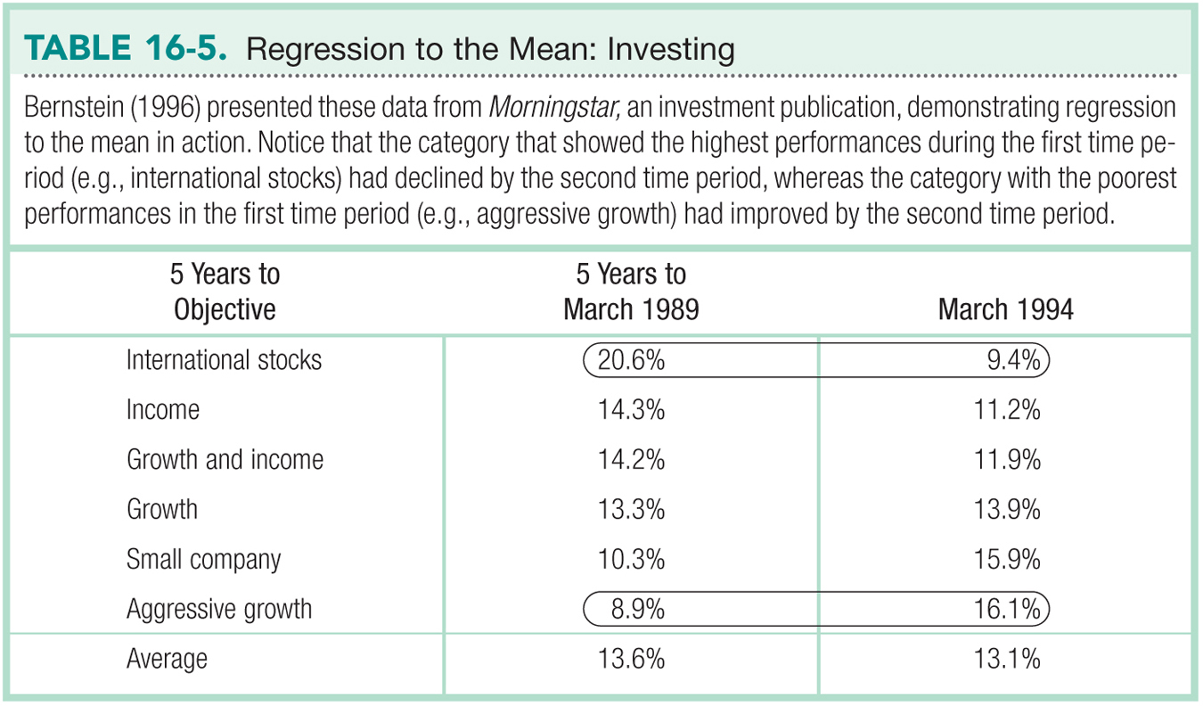

Slide 42
Other Regression Techniques
Multiple Regression
Stepwise Regression
SEM

Slide 43
Multiple Regression
A statistical technique that includes two or more predictor variables in a prediction equation

Slide 44
Stepwise Regression
A type of multiple regression in which computer software determines the order in which IVs are included in the equation.
It is the default in many computer software programs.
The strength of using stepwise regression is its reliance on data, rather than theory— especially when a researcher is not certain of what to expect in a study.

Slide 45
Structural Equation Modeling (SEM)
A statistical technique that quantifies how well sample data “fit” a theoretical model that hypothesizes a set of relations among multiple variables.
SEM encourages researchers to think of variables as a series of connections.

Slide 46
